Slide 1

SWAMI VIVEKANANDA INSTITUTE OF Science and technology project Name
SINGLE OBJECTIVE GENETIC ALGORITHM ON
TRAVELLING SALESMAN PROBLEM
GUIDE---- GROUP MEMBERS----
Asst. Prof. ANINDITA DAS *PRIYANKA CHAKRABORTY
*SUVRA MITRA
*SASWATI PRADHAN
*MALYASHREE BHADURI
*SWETA GHOSH
*DEBASMITA BASU
*MADHURIMA CHOWDHURY
*SAMPURNA CHATTERJEE

Slide 2
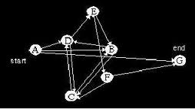
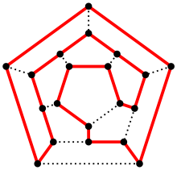
A) INTRODUCTION
What is TSP(Travelling Salesman Problem)?
--- finds the shortest possible route that visits each city exactly
once and returns to the original city
---It is an optimization problem that finds the best solution
from all feasible solutions.
What is Hamiltonian Cycle?
--A Hamiltonian path is a path that visits each vertex exactly once
. -- A graph that contains a Hamiltonian path is called a traceable graph
. -- A graph is Hamiltonian-connected if for every pair of
vertices there is a Hamiltonian path between the two vertices

Slide 3

B) Aim of the project
Cost Optimization
-Finds an alternative with the most cost effective or highest achievable
performance under the given constraints.
--maximizes desired factors and minimizes undesired ones.

Slide 4
C) GA--->TSP MAPPING
What is Genetic Algorithm?
-- A heuristic search that mimics the search problems and it generates solutions to optimization problems using techniques inspired by natural evolution, such as mutation, selection, and crossover process of natural evolution.
--This heuristic is routinely used to generate useful solutions to optimization.
--Genetic algorithm reduces time complexity.
Single objective GA(Genetic Algorithm)
is used to solve TSP

Slide 5

D) FLOW CHART OF GENETIC ALGORITHM
( steps for a single generation:)
START
PRODUCTION OF INITIAL CHROMOSOMES
SELECTION
CROSSOVER
MUTATION
REPLACING OLD POPUTATION BY NEW POPULATION
STOP

Slide 6
CONTINUED… 4 – City travelling salesman problem (Used in project:)
A
13
15
18
B
C
17
12
16
D

Slide 7
INPUT Data sets….. 1. CITY POOL 2. Cost pool
A B C D A A C B D A A D C B A A D B C A A B D C A A C D B A B C D A B B D A C B B A C D B B A D C B B C A D B B D C A B C B A D C C B D A C C A D B C C A B D C C D A B C C D B A C D A B C D D A C B D D B C A D D B A C D D C A B D D C B A D
15 17 16 18 13 17 12 18 18 16 17 15 18 12 17 13 15 12 16 13 13 16 12 15 17 16 18 15 12 18 13 17 15 13 16 12 15 18 16 17 17 13 18 12 12 16 13 15 17 15 18 16 17 12 18 13 13 18 12 17 13 15 12 16 16 18 15 17 16 12 15 13 18 15 17 16 18 13 17 12 12 17 13 18 12 15 13 16 16 13 15 12 16 17 15 12

Slide 8
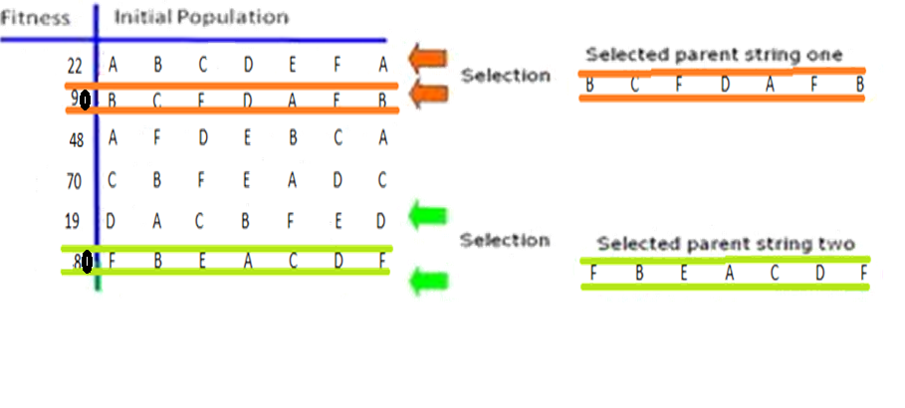
E) SELECTION
Individuals are chosen from a population for later breeding (recombination or crossover).
A generic selection procedure may be implemented as follows:
The fitness function is evaluated for each individual, providing fitness values, which are then normalized
The population is sorted by descending fitness values

Slide 9
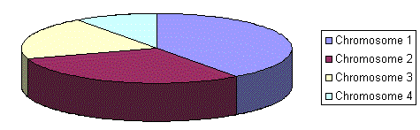
CONTINUED…
ROULETTE WHEEL SELECTION
Selection of the fittest one from a pool of individuals according to fitness function
Iterative process which participates in every generation
WORKING PRINCIPLE OF ROULETTE WHEEL SELECTION
let z=population size
let s = sum of all individual costs
i=2
while j<i
let r = random number in range [0, z ].
let k=ceil(s/r)
index=k%z
increment j
select individual #index for reproduction.
end while.
A Roulette-wheel marked for four individuals according to their fitness values. First individual has highest probability of selection .

Slide 10
F) CROSSOVER
Genetic operator used to vary the programming of a chromosomes in each generation.
A process of taking more than one parent individuals and producing child solutions from them.
(There are methods for selection of the parent chromosomes.)
PARENT 1
PARENT 2
CHILD 1
CHILD 2
B | C | F | D | A | E | B
F | B | E | A | C | D | F
B | C | F | A | C | D | F
F | B | E | D | A | E | B

Slide 11

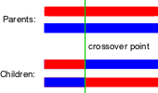
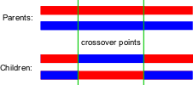

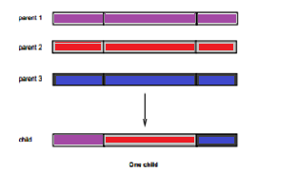
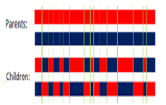
TYPES OF CROSSOVER:
1.ONE POINT CROSSOVER
2.TWO POINT CROSSOVER
3.CUT AND SPLICE
5.THREE PARENT CROSSOVER
4.UNIFORM CROSSOVER

Slide 12
CONTINUED…( Project Implementation).
Random position generated for crossover=4(say)
A
C
D
B
A
A
B
D
C
A
PARENT 1
PARENT 2
A
C
D
B
A
A
B
D
C
A
CHILD 1
CHILD 2

Slide 13
CONTINUED…
CHECKING IN CROSSOVER
Starting and ending nodes should be same
No duplication of nodes in between
ELITISM
Selecting individual with a bias towards the better ones
Comparison between parent and child chromosomes and selection of the one with
better fitness function and carrying it forward to the next generation pool.
Allows solutions to get better over time
1.ONE POINT CROSSOVER

Slide 14
CONTINUED….
Concept of Elitism
Best two out of the Parents and
Total Cost children are now put into the new
13 17 12 18 60 generation
Parent-1 13 16 12 15
13 16 12 15 56
Parent-2
13 16 12 15 56 13 16 12 15
Child-1
13 17 12 18 60
Child-2
A
C
B
D
A
A
C
D
B
A
A
C
D
B
A
A
C
D
B
A
A
C
D
B
A
A
C
B
D
A

Slide 15
G) MUTATION
alters one or more gene values in a chromosome from its initial state
the solution may change entirely from the previous solution
occurs during evolution according to a user-definable mutation before mutation
probability
preserves and introduces diversity
after mutation
WHY IS MUTATION NEEDED?
result in entirely new gene values being added to the gene pool.
may be able to arrive at better solution than was previously possible.
helps to prevent the population from stagnating at any local optima.
A | C | F | H | S | D | D
A | C | F | H | S | D | A

Slide 16
continued…..
TYPES OF MUTATION
1.FLIP-BIT
5.GAUSSIAN
2.BOUNDARY
4.UNIFORM
3.NON-UNIFORM

Slide 17
CONTINUED...
Before mutation:
( Offspring produced from crossover : )
A
B
C
D
D
After mutation :
( Boundary mutated, with a random gene A)
A
B
C
D
A

Slide 18
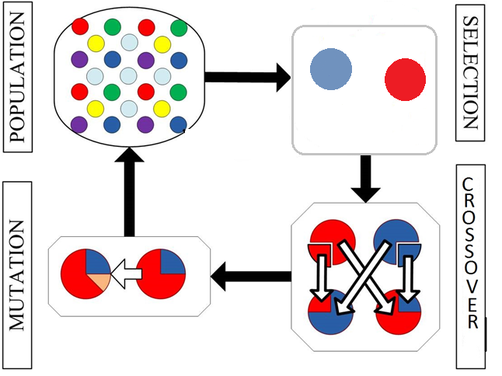
Process at a glance

Slide 19
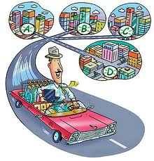
RESULTS
Total generations: 100
Crossover rate: 8.33%
Mutation rate: 40%
C A B D C 56
C A B D C 56
C A B D C 56
C A B D C 56
A B D C A 56
A C D B A 56
B C D A B 66
B A C D B 56
B A C D B 56
D C A B D 56
A B D C A 56
B D C A B 56
D B A C D 56
D B A C D 56
B A C D B 56
C A B D C 56
C D A B C 66
C D B A C 56
C A B D C 56
D A C B D 60
C A B D C 56
D B A C D 56
D C A B D 56
D C B A D 60

Slide 20
CONCLUSION (SCOPE OF THE PROJECT)
GA in future it can be applied on asymmetric Travelling Salesman problems also.
GA can also be applied on files taken from the OR library which are available on the Internet.
GA can also be applied by dynamic memory allocation for the varying sizes of populations.

Slide 21
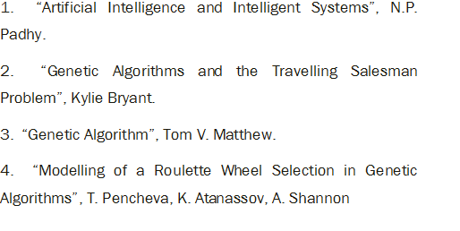
BIBLIOGRAPHY

Slide 22
THANK
YOU

